Slide 1
Proposal Talk 02.10.2017
Ioannis Agalliadis Institute of Medical Informatics, Uniklinik RWTH Aachen

Slide 2
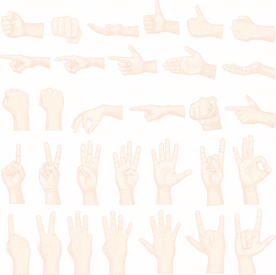
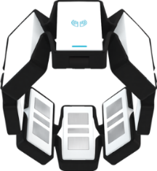
Finger gesture recognition with Myo
For different finger gestures -> find best detection accuracy.
Signals acquired with Myo.
Focus solely on EMG signals.
Notes:
Determine the best combination of features -> best detection accuracy among the different finger gestures.

Slide 3
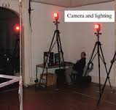
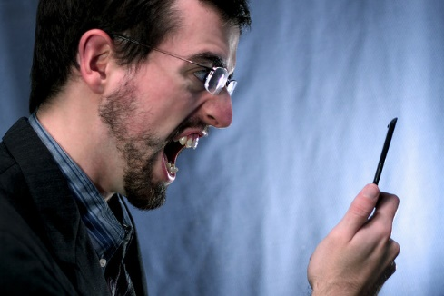
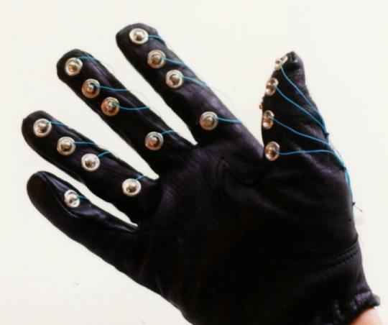
Why gesture recognition?
Image analysis requires ...
Voice recognition requires ...
Sensing gloves are expensive.
$$$
Notes:
-good and steady lighting conditions and lots of space
-to give voice commands when in public, makes things awkward

Slide 4
Why Electromyography?
Safe
Easy
Non-invasive
Why Myo?
Wireless
Cheap
No gel to facilitate conductivity

Slide 5
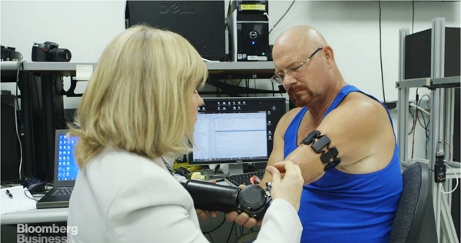
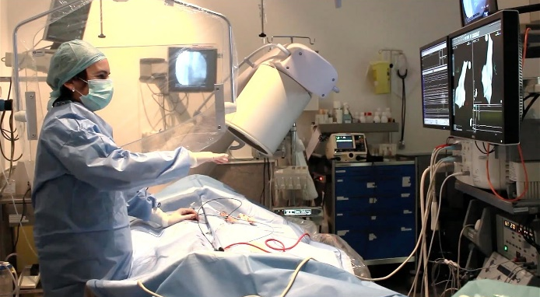
State of the art
A myo-controlled robotic arm was developed.
Myo helps surgeon to control interface during surgery.

Slide 6
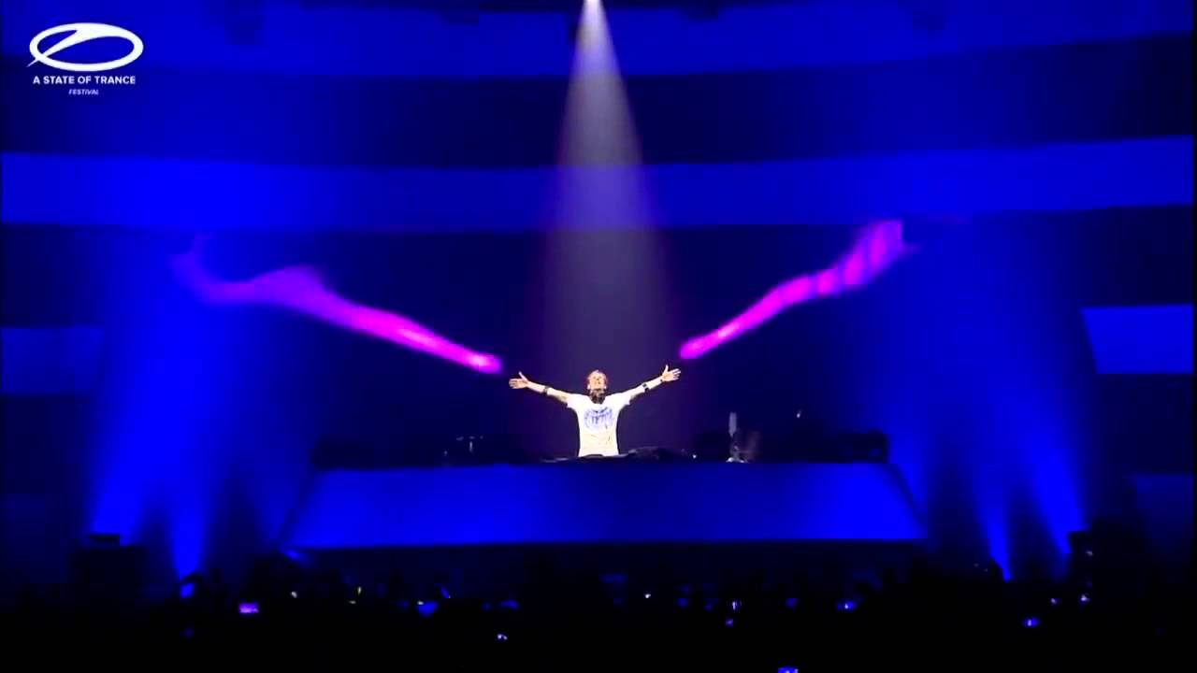
State of the art cont’d
Armin van Buuren controlled the stage effects during his performance.

Slide 7
Methods
128 window length of the raw EMG data
Extracted features:
Root-mean-square
Short-time fourier transform
Moving average
Various discrete wavelet transforms with different levels (haar, db8, sym4/8, bior1.3/2.2, coif3/4)
Classifiers:
kNN
SVM
ANN

Slide 8

Tasks
Raw EMG signals
Training data
Testing data
128 window length
EMG signals
Training Model
1
1-Fold Evaluation
5-Folds
Train & Test
1
2
3
4
5
Scores
Evaluation data
Feature extraction
Notes:
Collect EMG data with Myo.
Filter out the artifacts (variable frame rate).
Cut the individual gestures out of the total recordings.
Divide the data into five folds for train, test and one fold for evaluation data.
Extract features from data.
Train, test the classifier and find the most accurate classifications.
Repeat step 5 but make different combinations of train data with the features that gave the most accurate results.

Slide 9
Timeline
Methods, first results from NN -> Results
10/2017 - 11/2017
Combine most accurate Features -> Results,
Test new gestures
11/2017 – 12/2017
Test new gestures,
Results
12/2017 - 01/2018
Test new gestures,
Results
12/2017 - 01/2018
Discussion
02/2018 - 03/2018
Conclusion
03/2018 - 04/2018
Thesis Registration
Project Hand-Off
10/2017
04/2018
2017
Oct
Nov
Dec
Jan
Feb
Mar
Apr
2018

Slide 10
Summary
What I have done
Data collection
Artifacts removal
Created separate folds for train, test and evaluation data.
Data preprocess
Run SVM, ANN classifier
What I will do
Find the optimal parameters for SVM, ANN for the best detection accuracies.
Combine the best feature sets to increase the detection accuracies.

